Slide 1






Title: Intelligent Egypt Travel Companion Using AI – NileQuest
Name:
Abdelrhman Shokry ID: 232163 – Major: Software Engineering
Abraam Refaat ID: 234459 – Major: Software Engineering
Supervised By Dr. Ahmed Mohamed EL-Sayed EL-Shamy
TA Supervisor Eng. Hanaa Abdelahad Wakwak

Slide 2
Agenda
Introduction
Top Challenges Faced by Tourists in Egypt
Problem Definition
Objectives
Motivation
Related Work (1 & 2)
Dataset
System Architecture
Expected Outcomes
Requirements
Plan
References

Slide 3
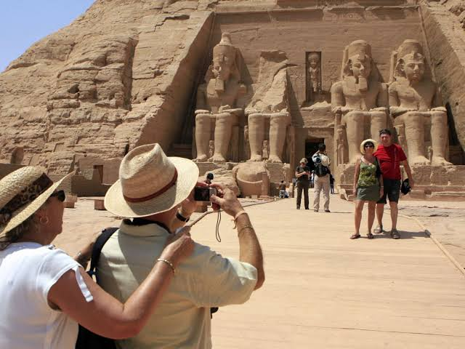
Introduction
The Intelligent Egypt Travel Companion is a smart tourism platform that enhances travel in Egypt by helping visitors discover destinations, plan trips, and enjoy a seamless travel experience.
Connects travelers with local businesses and promotes Egypt’s rich attractions.
Simplifies trip planning through personalized recommendations.
Drives tourism growth while creating new opportunities for service providers.

Slide 4


Top Challenges Faced by Tourists in Egypt
Trip Planning and Booking Frustration
Many tourists struggle to balance cultural exploration, leisure, and logistics due to fragmented information and inconsistent booking platforms, leading to repeated searches, pricing confusion, and overall frustration.
Booking Process
Complex booking steps and comparison shopping cause high abandonment rates (around 81%), creating inefficiencies for travelers planning multi-destination trips in Egypt.

Slide 5


Top Challenges Faced by Tourists in Egypt
Safety Concerns
While Egypt’s security has improved, tourists should stay updated on current conditions, follow travel advisories, and avoid high-risk areas. Use reputable tour operators and transportation for safety.
Language Barrier
Arabic is Egypt’s official language. English is common in tourist areas, but basic Arabic phrases or a translation app can help in less touristy regions.

Slide 6
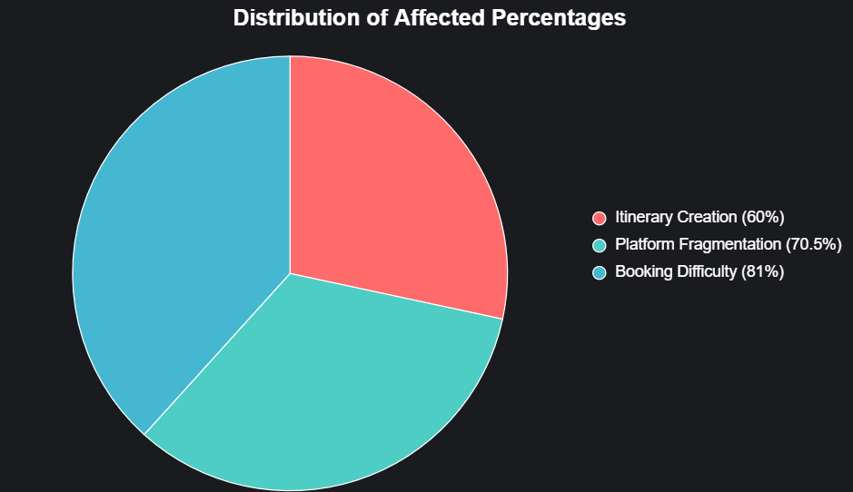
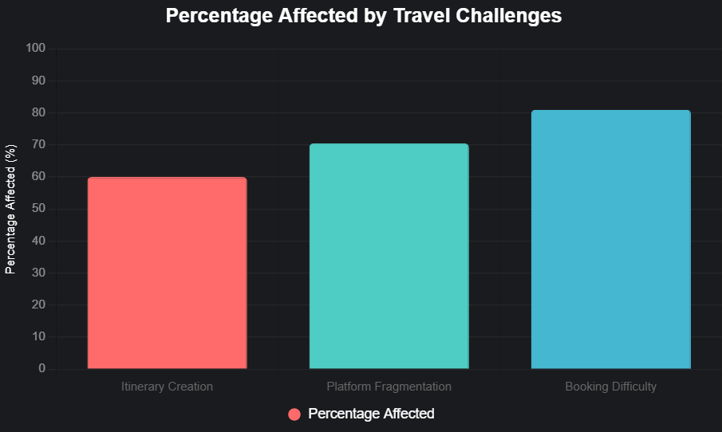
Top Challenges Faced by Tourists in Egypt
Challenge | Percentage Affected | Source
Itinerary Creation | ~60% (estimated from general surveys) | OECD Economic Surveys: Egypt 2024
Language Barriers | Significant portion | eVisa to Egypt (2024)
Platform Fragmentation | 70.5% mobile traffic issues | Navan (2025)
Booking Difficulty | 81% abandonment | TravelPerk (2024)

Slide 7
Problem Statement
Tourists visiting culturally rich destinations like Egypt encounter significant challenges that reduce travel satisfaction and decision-making efficiency. Studies show that travelers spend up to 16 hours planning and booking a single trip across multiple platforms.
Result: information overload and decision fatigue. Existing travel systems provide generic recommendations and fail to capture Egypt’s historical depth, regional diversity, and cultural nuances, leaving tourists to navigate fragmented resources, repetitive searches, and inefficient planning processes.
Priceline. (2024). New Priceline Research Finds Average Traveler Spends Two Full Work Days To Plan and Book Trips. Retrieved from https://press.priceline.com/new-priceline-research-finds-average-traveler-spends-two-full-work-days-to-plan-and-book-trips/

Slide 8
Objectives
Enhance Travel Experience: Deliver a seamless, personalized travel companion for Egypt tourists, reducing planning time from 16 hours to a streamlined process.
Improve Decision-Making: Reduce information overload and decision fatigue with tailored itineraries, real-time recommendations, and integrated bookings.
Cultural Promotion: Digitally showcase Egypt’s historical and cultural attractions, connecting tourists with local businesses.
Safety and Quality: Enhance tourism quality and tourist safety through emergency information and smart guidance.
Technical Skills: Provide hands-on experience in AI, NLP, recommendation systems, mobile app development.

Slide 9
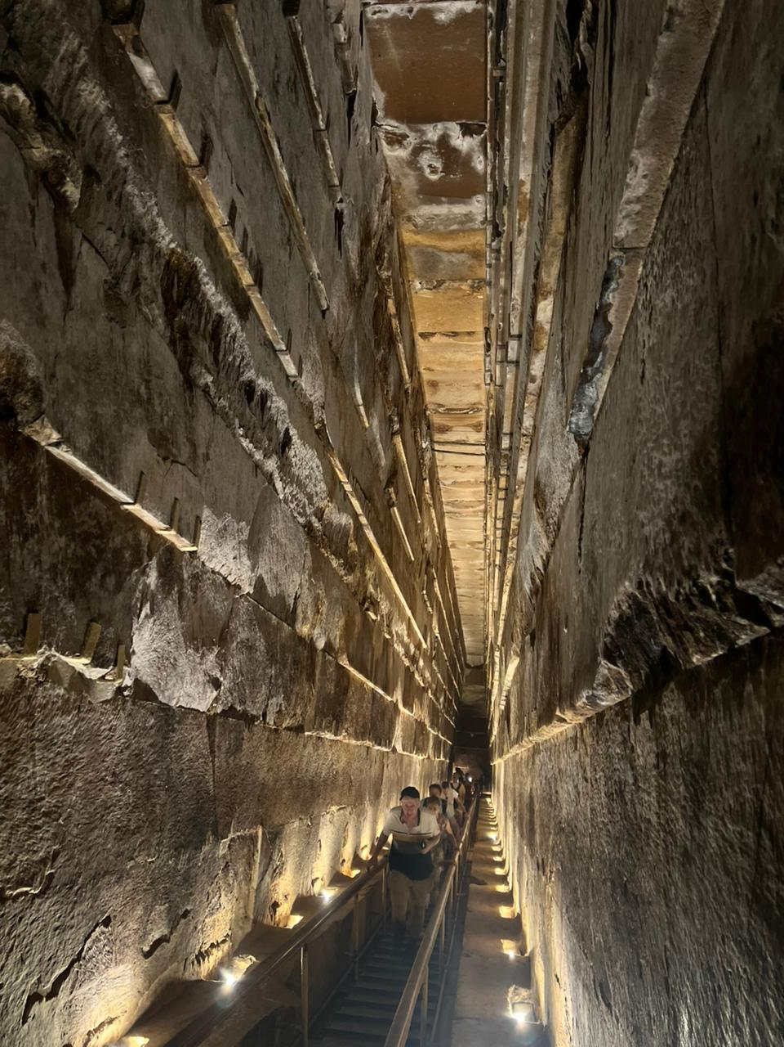
Motivation
Personal Connection: Inspired by pride in Egypt’s rich heritage and cultural values.
Addressing Issues: Motivated to reduce tourist scams, safety concerns, and poor experiences.
National Upliftment: Desire to enhance Egypt’s global image through smart tourism.
Dual Benefit: Aims to help tourists and boost local economy with better travel solutions.
Photo captured inside Great Pyramid on October 23, 2025, during research phase.

Slide 10
Related Work(1/2)
Literature Review : " The impact of Artificial Intelligence on improving tourism service quality in The Egyptian destination"
AI's Role in Tourism: AI revolutionizes Egyptian tourism with chatbots, recommendation systems, and data analytics, enabling personalized experiences and efficient operations (Sigala, 2020; Hsu et al., 2022).
Service Quality Importance: Drives satisfaction, loyalty, and repeat visits through personalization, safety measures, and cultural sensitivity (Azhar et al., 2019; Zenker & Kock, 2020).
AI Effects on Quality: Enhances service quality dimensions (reliability, responsiveness, empathy) via personalized recommendations, and virtual assistants (Fahim, 2019; Newgen, 2023).
Gaps:
Outdated Sources: Relies on pre-2024 literature; misses 2025 advancements like AI in tourism marketing, spending patterns, RAISA adoption (e.g., recent studies on Egypt).
Limited Scope: Focuses on general AI; ignores specific tools (offline support) and sectors like hotels/agencies; no sustainability focus.
Methodological Issues: Convenience sampling limits generalizability; lacks empirical data on AI's economic impacts or workforce effects in Egypt.

Slide 11
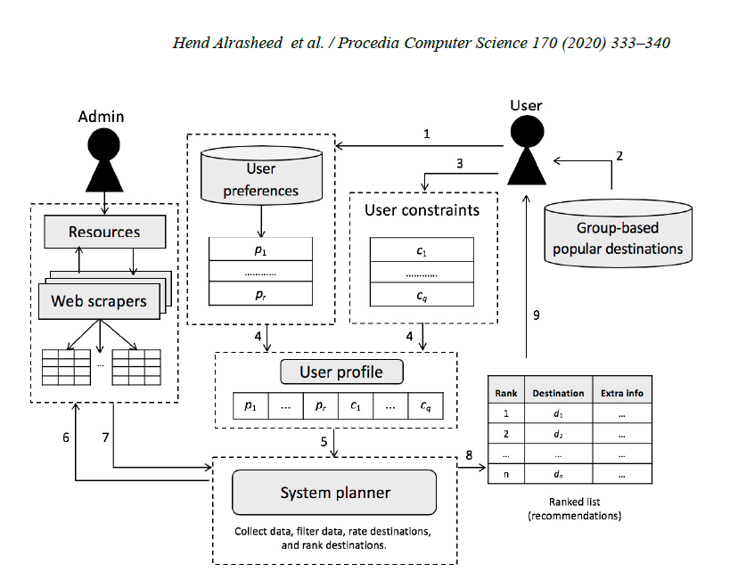
Related Work(2/2)
Literature Review: "A Multi-Level Tourism Destination Recommender System"
Hybrid Two-Level Architecture: Combines collaborative filtering (selects destinations popular among similar users) with knowledge-based filtering (ranks based on user preferences and constraints).
City-Level Destination Focus: Recommends initial destinations matching high-level needs (e.g., weather, cost, activities); does not support detailed, sequential itinerary planning within destinations.
Dynamic Contextual Data: Uses web scrapers for real-time data (accommodation prices, weather, safety, traffic) to ensure context-aware, up-to-date ranking.

Slide 12
Related Work(2/2)
Gaps:
Narrow Scope: Focuses only on city-level destination selection, ignoring detailed itinerary planning, cultural nuances, and local business integration specific to regions like Egypt.
No Implementation or Evaluation: Proposes a conceptual framework without real-world deployment, testing, or empirical validation of effectiveness.
Limited Dynamic Context: Relies on web scraping for basic real-time data (e.g., weather, prices) but lacks multimodal AI, NLP chatbots, or offline support for seamless user interaction.

Slide 13
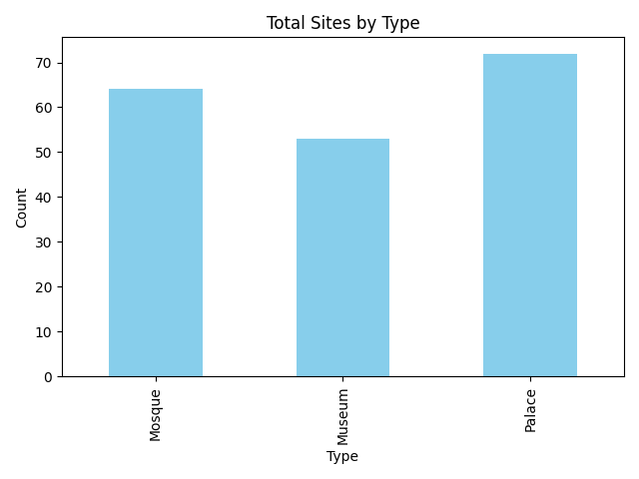
Dataset
The web-scraped dataset contains comprehensive information about Egypt’s most significant tourist and heritage sites, including mosques, palaces, museums. It was compiled from multiple verified online sources to provide an integrated view of Egypt’s cultural and historical landmarks.
Each record in the dataset represents a unique attraction, enriched with essential geographical, operational, and visitor-related attributes that support tourism analytics, recommendation systems, and itinerary generation.

Slide 14
Dataset
Availability of Mature External Models: Pre-trained models (Dialogflow, Rasa, etc.) already provide state-of-the-art performance in NLP, multimodal reasoning, and text summarization.
Dynamic, Real-Time Use: The system operates on user-provided, real-time content. Each user generates their own contextual data dynamically.

Slide 15
APIs
Scalability and Reliability APIs like Mapbox, Google Places, Airbnb, Amadeus or Skyscanner handle billions of requests daily.
Continuous Improvement External APIs are continuously updated with newer, more accurate models.
Focus on Educational Innovation Outsourcing ML infrastructure allows the team to focus on user experience, accessibility.

Slide 16
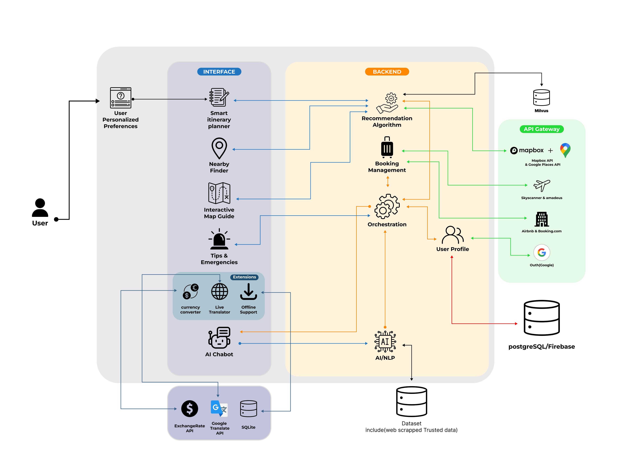
System Architecture

Slide 17
Expected Outcomes
A unified, AI-powered travel platform that combines planning, booking, and real-time guidance — eliminating the need for multiple apps.
Faster, stress-free trip planning with personalized itineraries generated in minutes, improving user satisfaction.
Confident exploration of Egypt for all visitors, even first-timers, via multilingual AI support and real-time recommendations.
Smarter, evolving suggestions driven by user behavior and feedback, promoting hidden gems and cultural experiences.
Practical mastery of full-stack development, AI/NLP integration, API orchestration, and cloud deployment in a real-world mobile-first app.

Slide 18
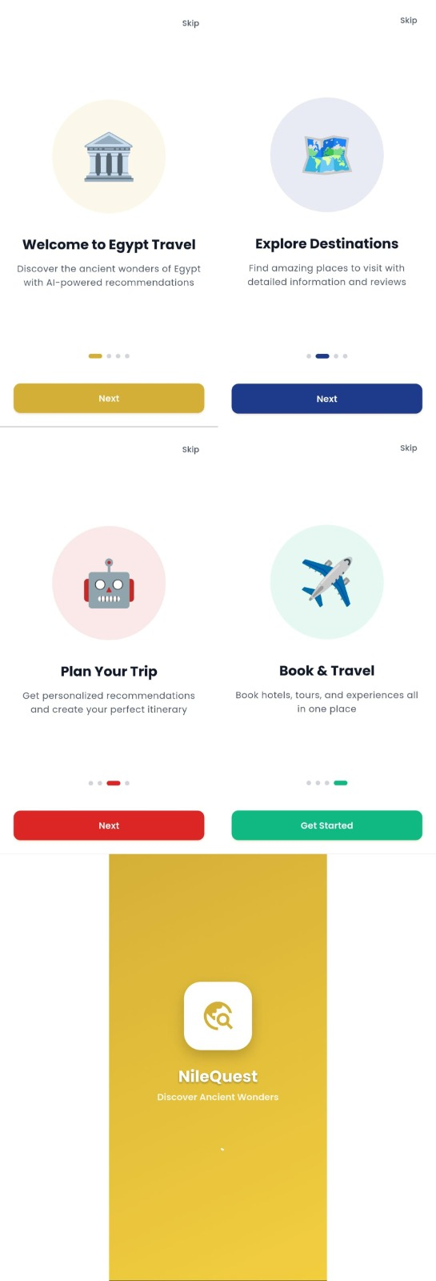
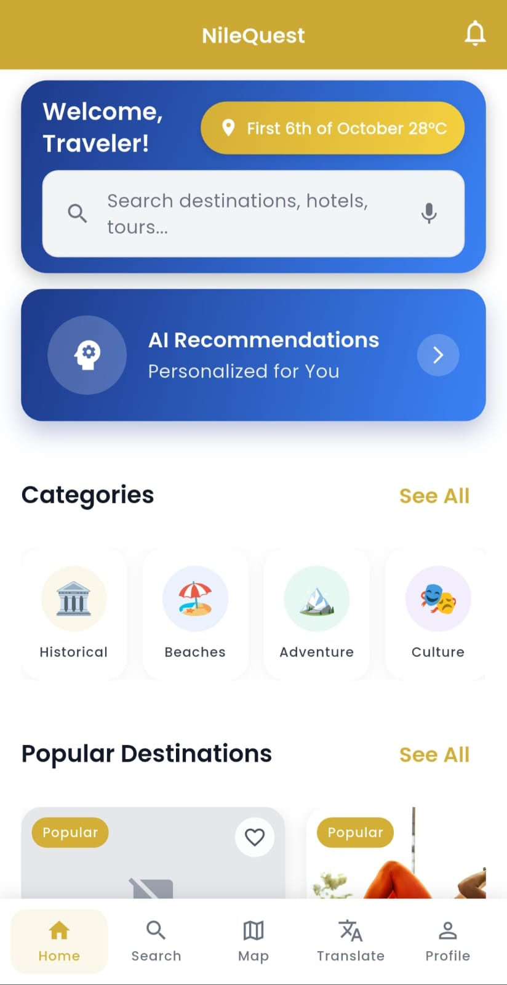
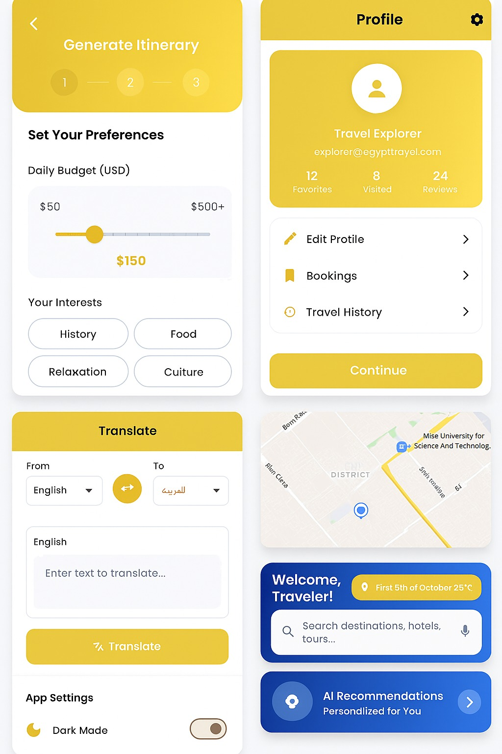
Prototype

Slide 19
Requirements
Software & Tools:
Python (with Flask or Django framework)
Flutter SDK
An IDE (e.g., VS Code, Android Studio)
Notion (for project management and issue tracking)
Git & GitHub (for version control and CI/CD integration)
Infrastructure & Services:
Cache: SQLite
Vector Database: Milvus (for AI-powered recommendation engine)
Database: PostgreSQL / Firebase
Hosting: AWS / Firebase Hosting
APIs: Mapbox Maps, Google Places, Amadeus, Skyscanner , Google Translate
Authentication: OAuth (Google)

Slide 20
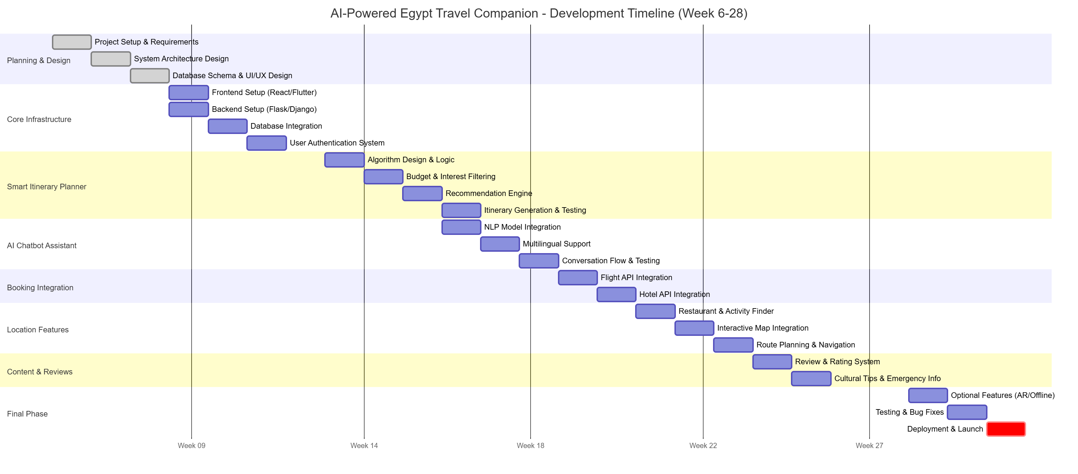
Plan

Slide 21
References
eVisa to Egypt. (2024). Top Challenges Faced by Tourists in Egypt. Retrieved from https://evisa-to-egypt.info/blog/top-challenges-faced-by-tourists-in-egypt/
Navan. (2025). 87 Online Travel and Hotel Booking Stats [2025]. Retrieved from https://navan.com/blog/online-travel-booking-statistics
OECD. (2024). OECD Economic Surveys: Egypt 2024. Retrieved from https://www.oecd.org/content/dam/oecd/en/publications/reports/2024/02/oecd-economic-surveys-egypt-2024_ad9fc8a4/af900de2-en.pdf
TravelPerk. (2024). 70+ Online Travel Booking Statistics and Trends [2025]. Retrieved from https://www.travelperk.com/blog/online-travel-booking-statistics/
Priceline. (2024). New Priceline Research Finds Average Traveler Spends Two Full Work Days To Plan and Book Trips. Retrieved from https://press.priceline.com/new-priceline-research-finds-average-traveler-spends-two-full-work-days-to-plan-and-book-trips/
Shalan, I. S., Gaafar, H., Al-Romeedy, B., & Shawaly, A. E. F. (2024). The impact of Artificial Intelligence on improving tourism service quality in The Egyptian destination. Retrieved from https://mfth.journals.ekb.eg/article_385750_9eeee543d5964bbf1fe5234588ebd461.pdf
Alrasheed, H., Alzeer, A., Alhowimel, A., Alshameri, N., & Althyabi, A. (2020). A multi-level tourism destination recommender system.Retrieved from https://www.researchgate.net/publication/340636521_A_Multi-Level_Tourism_Destination_Recommender_System/fulltext/5e96668792851c2f52a2de6c/A-Multi-Level-Tourism-Destination-Recommender-System.pdf?_tp=eyJjb250ZXh0Ijp7ImZpcnN0UGFnZSI6InNpZ251cCIsInBhZ2UiOiJwdWJsaWNhdGlvbiJ9fQ

Slide 22


